Slide 1
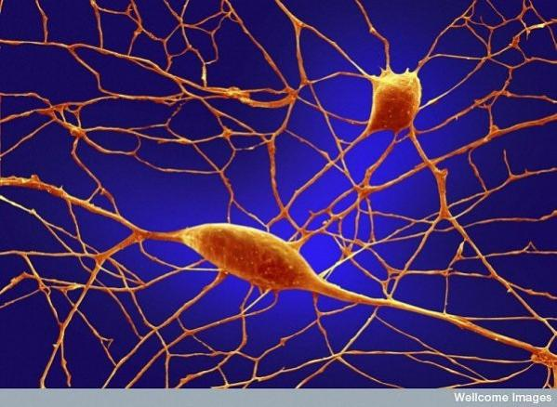

Slide 2
Nerve cell (Neuron) Structure and Function
Neurons are the oldest and longest cells in the body. You have many of the same neurons for your whole life. Although other cells die and are replaced, many neurons are never replaced when they die.
Neurons are part of a huge network of cells that form pathways for signals to travel. This pathway controls everything that your body does.
Neurons have specialized cell parts called dendrites and axons. Dendrites branch out like a tree and bring electrical signals to the cell body from axons and axons take information away from the cell body toward other cells. The axon is the main conducting unit of the neuron, capable of conveying electrical signals along distances that range from as short as 0.1 mm to as long as 2 m.
The myelin sheath protects the axon, and prevents interference between axons as they pass along in bundles, sometimes thousands at time.
Neurons contain some specialized structures called synapses. Synapses are the spaces between dendrites and axon terminals. Once the electrical signal traveling along the axon reaches the synapse a chemical signal is triggered and crosses the synapse to the next receiver.
Neurons contain a nucleus which controls the cell’s activities

Slide 3
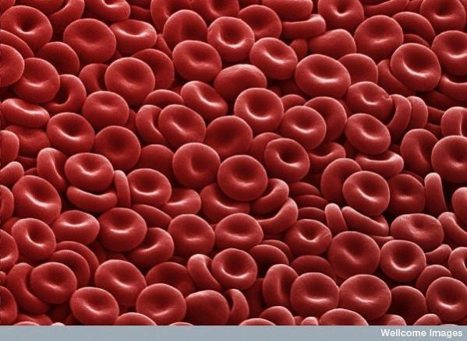

Slide 4
Red Blood Cell (erythrocytes) Structure and Function
A red blood cell is a biconcave disc. Simply it is a round ball that is squeezed from two opposite ends to appear, widest at the sides and narrowest in the middle.
A red blood cell measures about 6 to 8 micrometers in diameter, with an average thickness of 2 micrometers. Although a red blood cell is wider than some capillaries( capillaries are tubes that carry blood), its flexibility allows it to become distorted as it squeezes through narrow passages and then restores to its original shape.
The average male adult has about 5 million red blood cells per cubic millimeter of blood, while the average female adult has about 4.5 million red blood cells per cubic milliliter of blood. The number of red blood cells may vary depending on geographical location – a person who lives in high altitudes will have more red blood cells.
Red blood cells have an unusual structure compared to other cells in the human body. RBCs lack a nucleus, mitochondria and endoplasmic reticulum. This absence of these internal cell structures contributes to the cells’ flexibility and allows space to carry hemoglobin.
RBCs carry hemoglobin, a protein responsible for carrying oxygen from the lungs to the organs and tissues of the body. A RBC doesn’t need a nucleus to control it because it is pumped arund the body by the heart.
The main function of a RBC is to carry oxygen.

Slide 5
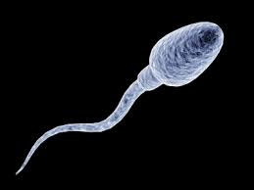

Slide 6
Sperm cell Structure and Function
A sperm cell is composed of a head, middle piece and tail.
The head contains a nucleus carrying information from dad that will later be mixed with information inside of an egg to create a single cell that will eventually become a baby.
The head also contains an acrosome. Inside the acrosome are digestive enzymes that will help the sperm enter the egg cell. The enzymes destroy the protective layer around the egg.
The middle piece has a lot of energy producing structures called mitochondria. This energy is needed for the tail to move the sperm as they race toward the egg.
An average human ejaculation contains 200-300 million sperm. The more sperm created, the higher the chances of successful fertilization of the egg. Only one sperm will be successful at penetrating the egg.
New sperm cells are made about every 3 months. Sperm do not age the way that women’s eggs age because the body keeps making new ones.
The tail of the sperm contains proteins that move the tail using the energy created in the middle piece.

Slide 7
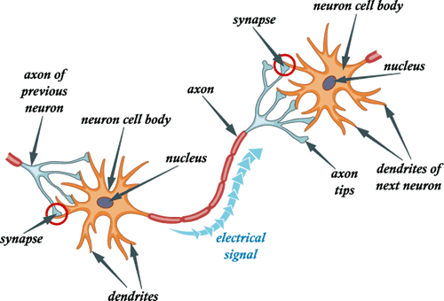
Nerve cell (Neuron) Structure and Function

Slide 8
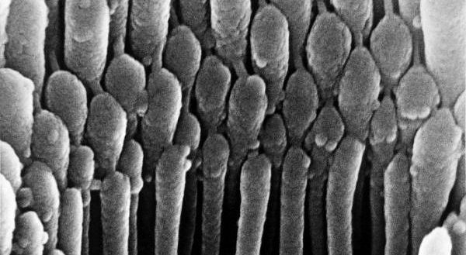

Slide 9
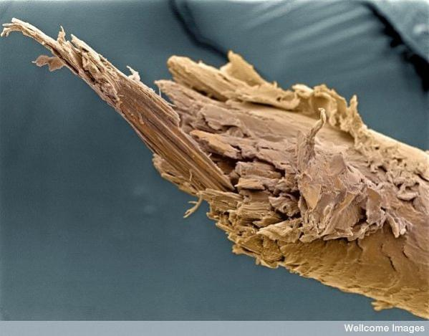

Slide 11
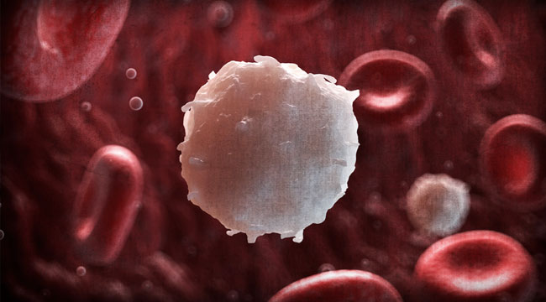

Slide 12
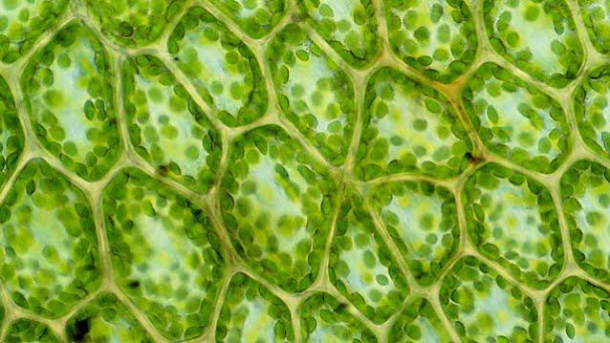

Slide 14
