Slide 1
Nervous System

Slide 2
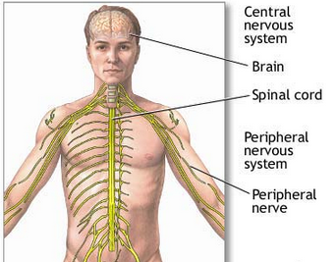
Central Nervous System Peripheral Nervous System

Slide 3
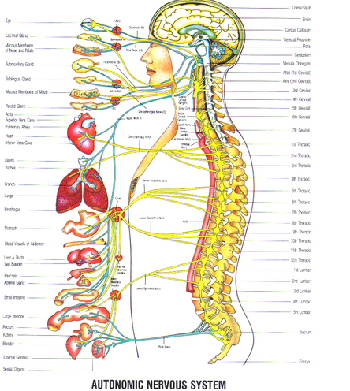
Autonomic Nervous system
Structures: [organs, muscles], nerves, brain, spinal cord
Functions: Involuntary functions such as heart beating, stomach, intestines, saliva, liver etc.

Slide 4
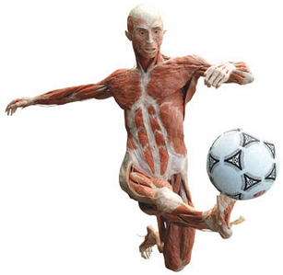
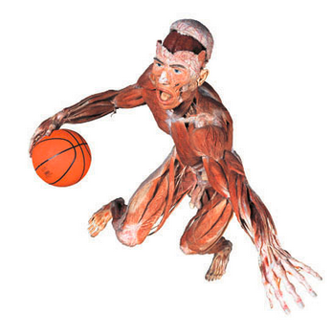
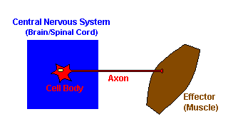
Somatic Nervous System Structures: [muscles], nerves, brain, spinal cord Functions: Voluntary movement

Slide 5
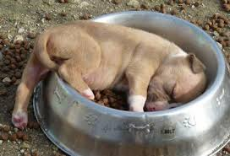
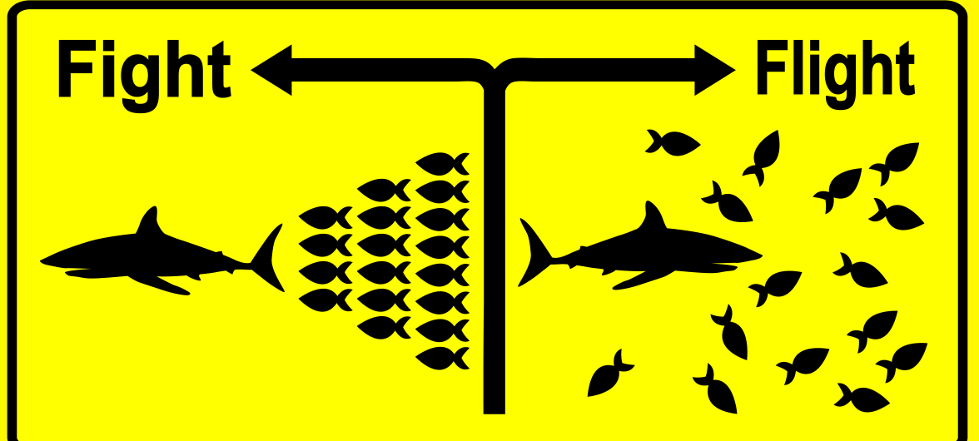
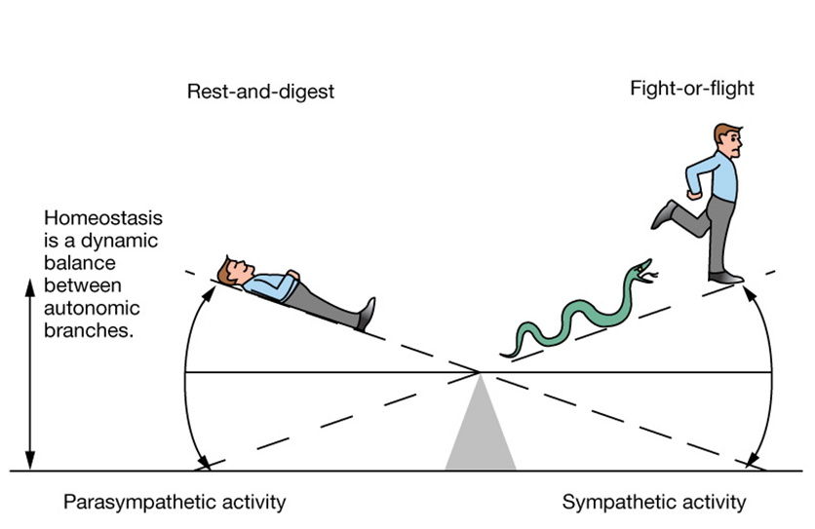

Slide 6
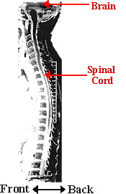
Spinal cord
The spinal cord is the main pathway for information connecting the brain and peripheral nervous system. The human spinal cord is protected by the bony spinal column made up of vertebrae.
Function: The spinal cord acts as the middle man between the brain and the body. Messages from the brain to the body travel. If the spinal cord becomes injured, then the messages between the brain and body are no longer clearly relayed.
A pair of spinal nerves leaves each segment of the spinal cord and extends into the body

Slide 7
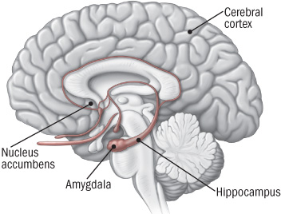

Slide 8
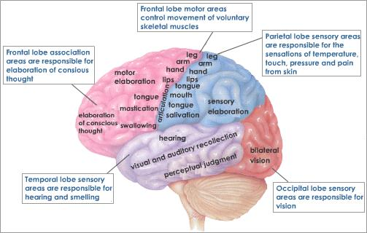
Cerebral Cortex (Cerebrum)

Slide 9
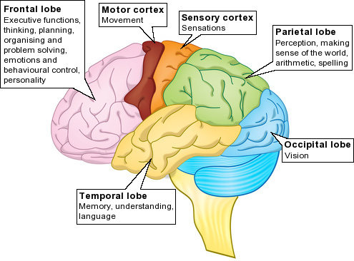

Slide 10
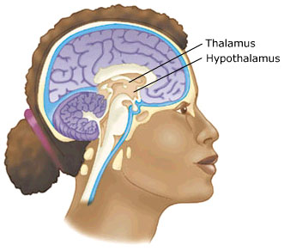

Slide 11
The hippocampus is a small organ located within the brain's medial temporal lobe and forms an important part of the limbic system, the region that regulates emotions. The hippocampus is associated mainly with memory, in particular long-term memory. The organ also plays an important role in spatial navigation.
Damage to the hippocampus can lead to loss of memory and difficulty in establishing new memories. In Alzheimer's disease, the hippocampus is one of the first regions of the brain to be affected, leading to the confusion and loss of memory so commonly seen in the early stages of the disease.

Slide 12
